Slide 1

Heart Disease Prediction
Project Supervisor : Ms. S. Nithya, M.E.,
Name of the Student : M .Chidanand
Register Number : 39110575

Slide 2
Presentation Outline
Course Certificate
Introduction
Objectives
System Architecture / Ideation Map
Project Implementation
Application Snapshots
Result and discussions
Conclusion
References

Slide 3
Course Certificate

Slide 4
Introduction
Heart is an important organ of the human body. It pumps blood to every part of our anatomy.
If it fails to function correctly, then the brain and various other organs will stop working, and within few minutes, the person will die.
Heart disease is one of the biggest causes of morbidity and mortality among the population of the world.
Machine Learning helps in predicting the Heart diseases, and the predictions made are quite accurate.

Slide 5
Objective
The objective of this study is to effectively predict if the patient suffers from heart disease.
The health professional enters the input values from the patient's health report.
The data is fed into model which predicts the probability of having heart disease
To find whether which algorithm is better

Slide 6
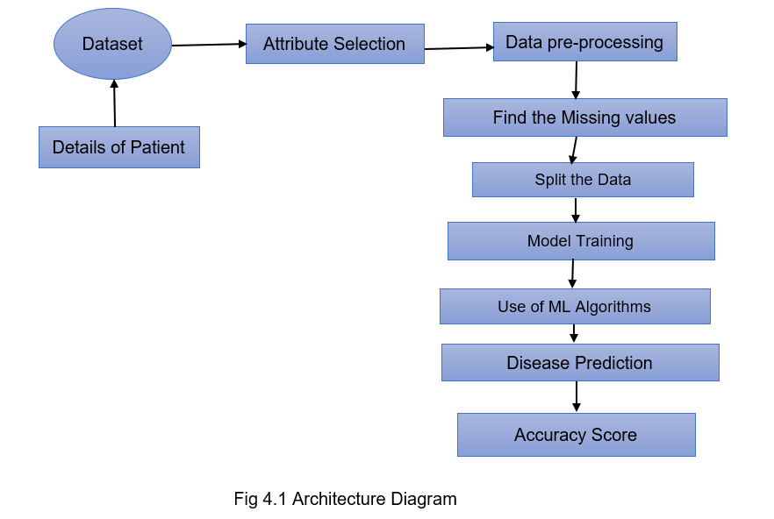
System Architecture / Ideation Map

Slide 7
Project Implementation
The Working System is implemented using the following modules.
1.) Collection of Dataset
2.) Selection of attributes
3.) Data Pre-Processing
4.) Balancing of Data
5.) Disease Prediction

Slide 8
Collection of dataset
Initially, we collect a dataset for our heart disease prediction system.
After the collection of the dataset, we split the dataset into training data and testing data.
The training dataset is used for prediction model learning and testing data is used for evaluating the prediction model.
For this project, 80% of training data is used and 20% of data is used for testing.
The dataset used for this project is Heart.csv The dataset consists of 303 Samples consisting of 14 attributes.

Slide 9
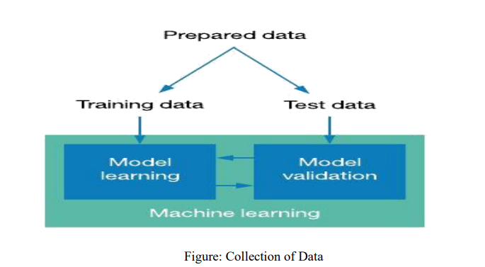
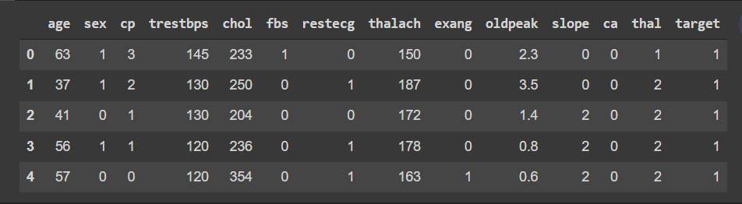

Slide 10
Selection of attributes
Attribute or Feature selection includes the selection of appropriate attributes for the prediction system.
This is used to increase the efficiency of the system.
Various attributes of the patient like gender, chest pain type, fasting blood pressure, serum cholesterol, exang, etc are selected for the prediction.
The Correlation matrix is used for attribute selection for this model

Slide 11
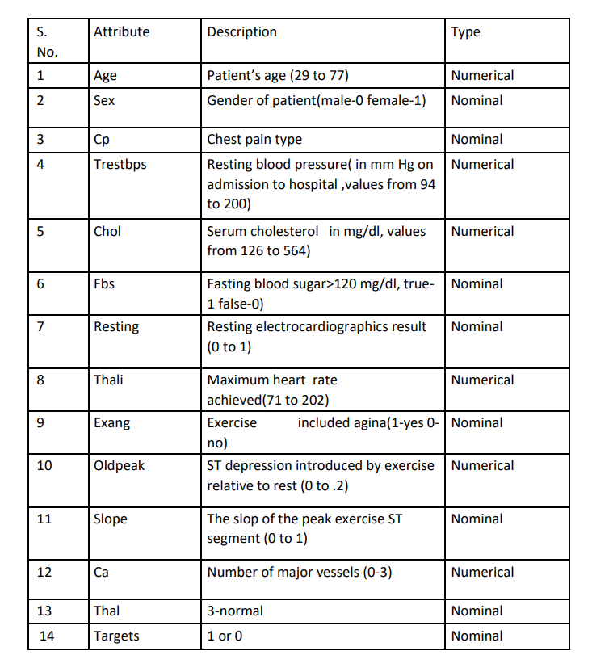

Slide 12
Pre-processing of Data
Data pre-processing is an important step for the creation of a machine learning model. Data pre-processing has the activities
Getting the dataset
Importing libraries
Importing datasets
Finding Missing Data
Encoding Categorical Data
Splitting dataset into training and test set
Feature scaling
Preprocessing of data is required for improving the accuracy of the model

Slide 13
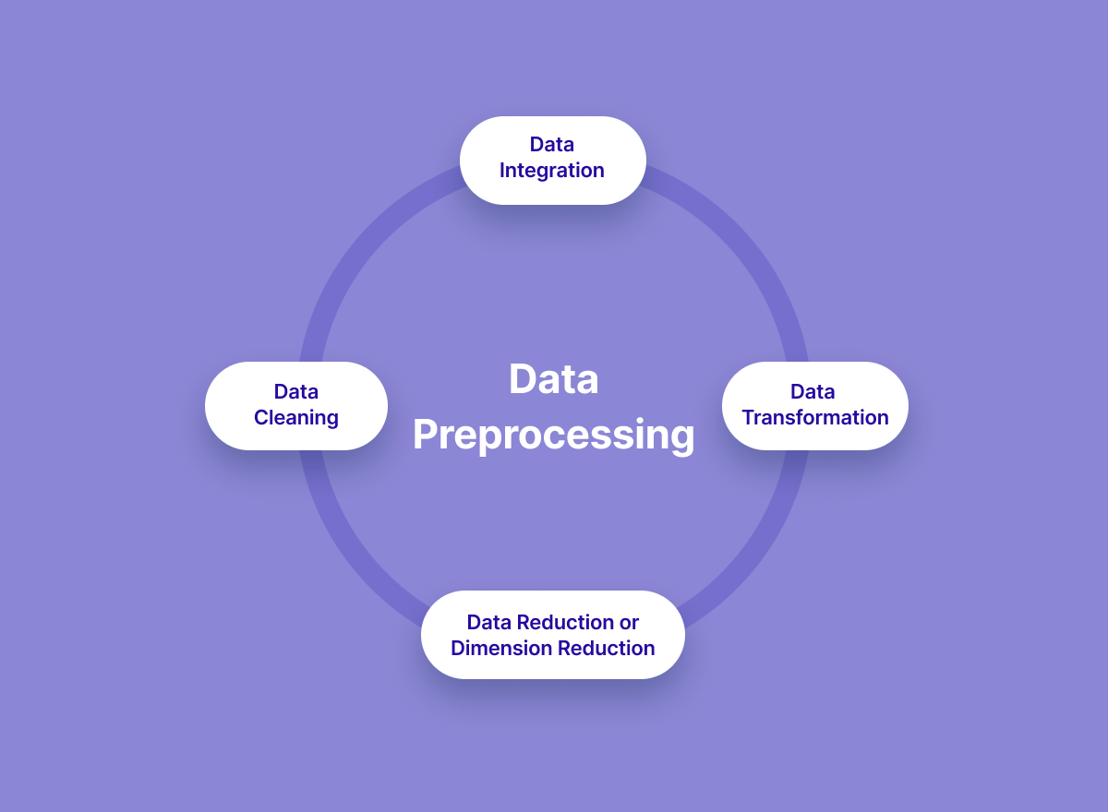

Slide 14
Balancing of Data
Imbalanced datasets can be balanced in two ways. They are Under Sampling and Over Sampling
(a) Under Sampling: In Under Sampling, dataset balance is done by the reduction of the size of the ample class. This process is considered when the amount of data is adequate.
(b) Over Sampling: In Over Sampling, dataset balance is done by increasing the size of the scarce samples. This process is considered when the amount of data is inadequate.

Slide 15
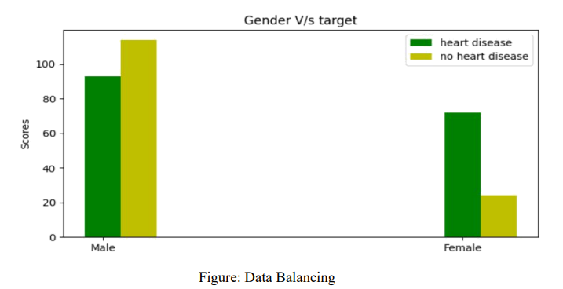

Slide 16
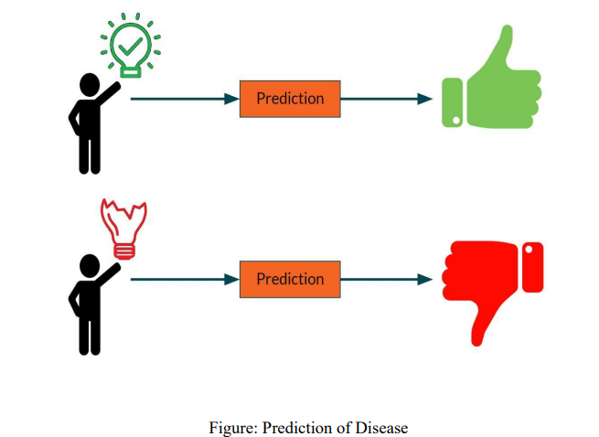
Prediction of Disease
Various machine learning algorithms like Simple linear Regression ,Logistic Regression, KNN are used for classification. Comparative analysis is performed
Among All the algorithms and the algorithm that gives the highest accuracy is used for heart disease prediction.

Slide 17
Logistic Regression
Logistic regression is one of the most popular Machine Learning algorithms, which comes under the Supervised Learning technique.
It is used for predicting the categorical dependent variable using a given set of independent variables.
Logistic regression predicts the output of a categorical dependent variable. Therefore, the outcome must be a categorical or discrete value.
It can be either Yes or No, 0 or 1, true or False, etc. but instead of giving the exact value as 0 and 1, it gives the probabilistic values which lie between 0 and 1.
Logistic Regression is a significant machine learning algorithm because it has the ability to provide probabilities and classify new data using continuous and discrete datasets.

Slide 18
Methodology
To predict the output using Simple Linear Regression and Polynomial Regression.
Jupyter notebook is used to code in python language and libraries used are sklearn ,pandas ,numpy ,matplotlib and machine learning algorithm used is decision tree regressor.
Using Simple Linear Regression ,Polynomial Regression, Logistic Regression, KNN we achieved to predict our output ,hence achieve our goal.
By visualizing the predicted data we get to know how best is our trained model.

Slide 19
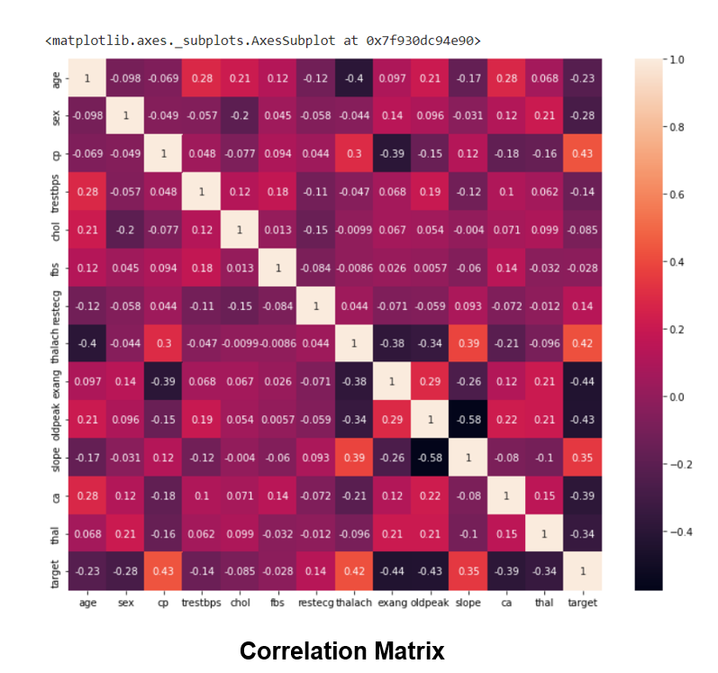
Performance Analysis

Slide 20
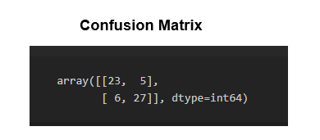
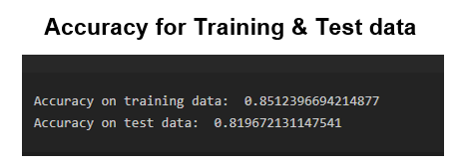
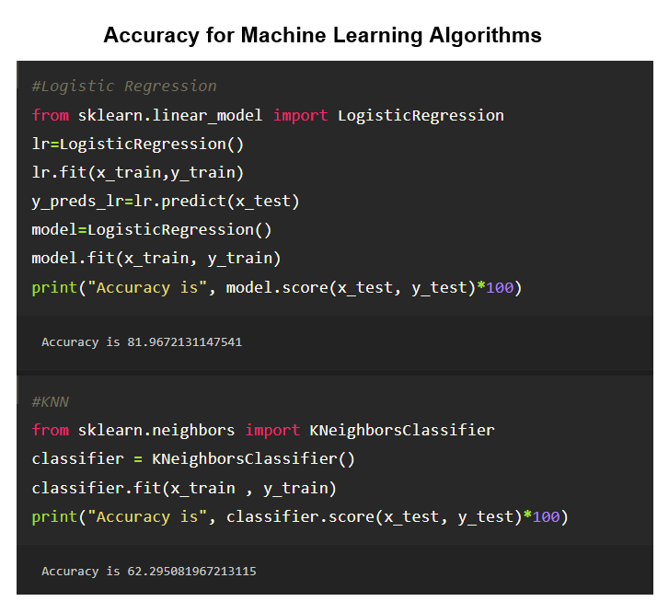

Slide 21
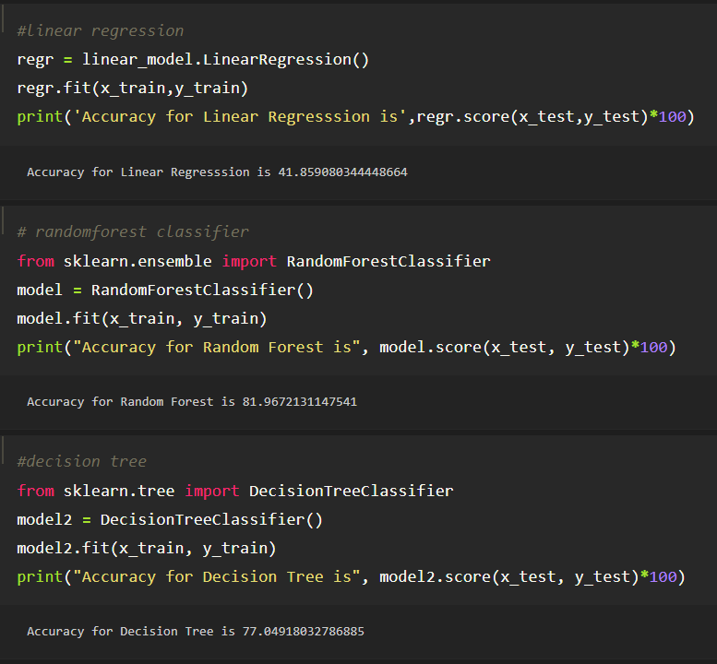

Slide 22
Result
The data classification technique namely Simple Linear Regression, Logistic Regression, KNN, Decision Tree, Random Forest were applied.
Logistic and Random Forest algorithms are having Better Accuracy values than others.
The goal of our heart disease prediction project is to determine if a patient should be diagnosed with heart disease or not .
It is a Binary outcome, so: Result = 1, the patient will be diagnosed with heart disease a processing.
Result=2 ,the patient does not have a heart disease.

Slide 23
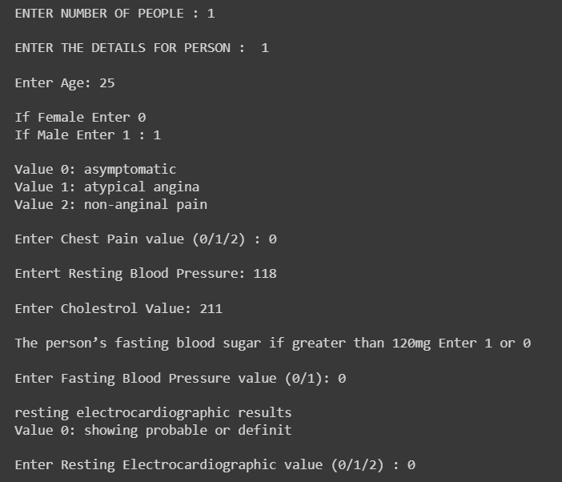
Output

Slide 24
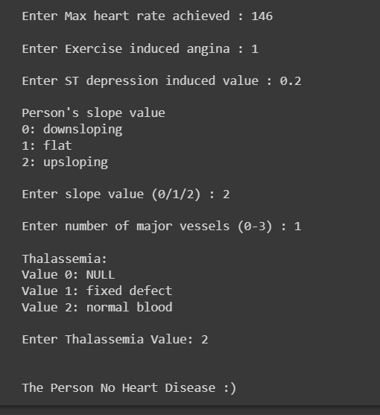

Slide 25
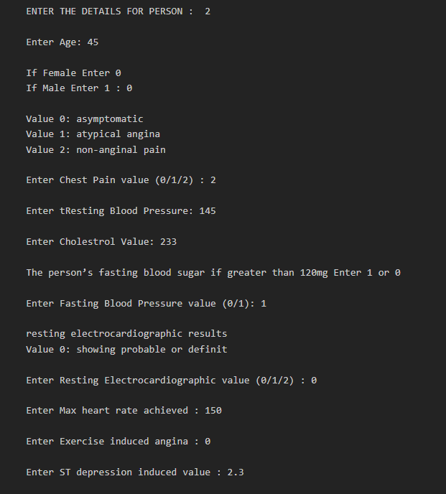

Slide 26
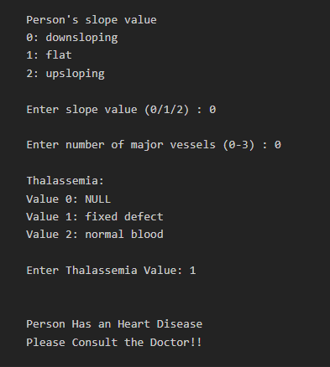

Slide 27
Conclusion
In this paper, the different machine learning algorithms used to measure the performance are Simple Linear Regression, Random Forest, Decision Tree Logistic Regression, KNN applied on the dataset.
With the increasing number of deaths due to heart diseases, it has become mandatory to develop a system to predict heart diseases effectively and accurately.
The correct prediction of heart disease can prevent life threats, and incorrect prediction can prove to be fatal at the same time.
In this paper different machine learning algorithms are applied to compare the results and analysis of the UCI Machine Learning Heart Disease dataset.

Slide 28
References
[1] Soni J, Ansari U, Sharma D & Soni S (2011). Predictive data mining for medical diagnosis: an overview of heart disease prediction. International Journal of Computer Applications, 17(8), 43-8
[2] Ganna A, Magnusson P K, Pedersen N L, de Faire U, Reilly M, Ärnlöv J & Ingelsson E (2013). Multilocus genetic risk scores for coronary heart disease prediction. Arteriosclerosis, thrombosis, and vascular biology, 33(9), 2267-72.
[3] https://www.researchgate.net/publication/349470771_Using_Machine_Learning_for_Heart_Disease_Prediction

